Slide 1
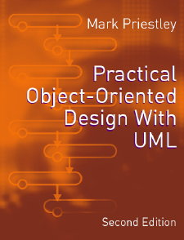
PRACTICAL
OBJECT-ORIENTED
DESIGN WITH UML
2e
Chapter 14:
Principles and Patterns

Slide 2
Principles and Patterns
The activity of design can be informed by
  principles: general statements of what properties a design ought to have
  patterns: concrete examples of successful designs for particular purposes

Slide 3

System Evolution
How can we insulate modules from change?
We would like to be able to change modules without affecting their clients
  this will increase the maintainability of the system

Slide 4
Open and Closed Modules
A module is said to be closed if it is not subject to further change
  clients can then rely on the services the module provides
A module is said to be open if it is still available for extension
  this will make it possible to extend and modify the system

Slide 5
The Open-Closed Principle
Open and closed modules both have advantages
The open-closed principle states that developers should try to produce modules that are both open and closed
This sounds like a paradox
  to resolve it we need a way of making a module extendible without having to change it

Slide 6
Interface and Implementation
The interface of a module is what is visible or available to clients
The implementation is the internal details of the module that support the interface
One approach to open-closed modules is to ensure that clients only depend on the interfaces of the modules they use
  and make it possible to change the implementations freely

Slide 7
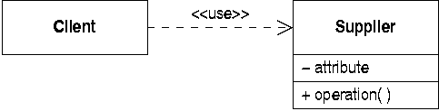
Data Abstraction
Data abstraction assigns an access level to each feature in a class
Clients can use only the public interface
Private features - eg method bodies - can be freely changed

Slide 8
Limitations
Even with data abstraction, Java classes are technically not closed
  changes to method bodies affect the source code and entail recompilation of clients
The interface actually used by clients is left implicit

Slide 9
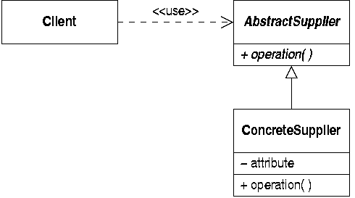
Abstract Interface Classes
An approach based on generalization

Slide 10
How the Interface Works
Clients access different concrete suppliers through the abstract supplier interface
This is enabled by features of the object-oriented programming paradigm
  polymorphism: a reference to the interface class can actually refer to any implementation class
  dynamic binding: messages to the interface are passed on the appropriate implementation class

Slide 11
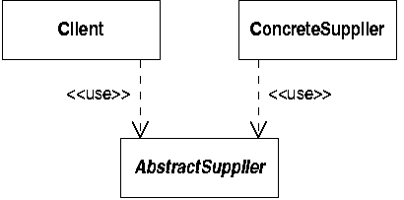
Dependencies
The dependency structure indicates that the client is independent of the concrete suppliers

Slide 12
Open and Closed
The abstract supplier class is
  open in the sense that its functionality can be extended by adding further subclasses
  closed in that this can be done without affecting clients
However, the client is not protected against changes in the interface exported by the abstract supplier class

Slide 13
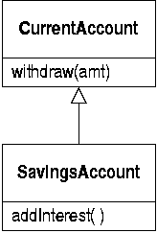
No Concrete Superclasses
It has sometimes been recommended that all superclasses in a system should be abstract
Often subclasses are added to concrete classes as a system evolves

Slide 14
A Dependency Problem
The savings account class is now dependent on the current account class
  changes to the current account - altering functionality or adding and removing operations - will affect savings accounts
This leads to problems
  the changes may not apply to savings accounts
  the code may become cluttered with checks for special cases

Slide 15
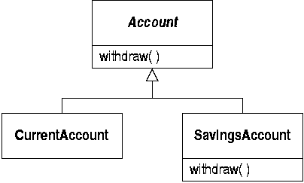
‘Refactoring’ the Design
A better approach is to introduce an abstract interface class
  even if it initially seems unnecessary

Slide 16
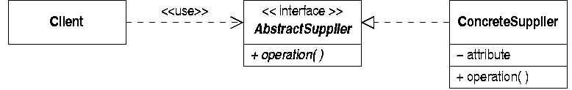
Decoupling Interfaces
Clients can be protected from interface change by defining separate interface and implementation hierarchies
Make the abstract supplier an interface:

Slide 17
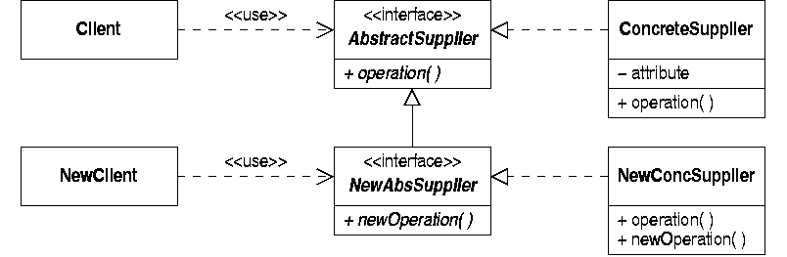
Separate Interface Hierarchy
Extend the interface to add a new operation
  abstract supplier can be extended without affecting existing clients

Slide 18
Liskov Substitution Principle
States the conditions under which references to superclasses can safely be converted to references to subclasses
  “it must be possible to substitute an instance of a subclass for an instance of a superclass without affecting client classes or modules”
  this defines what generalization means in UML

Slide 19
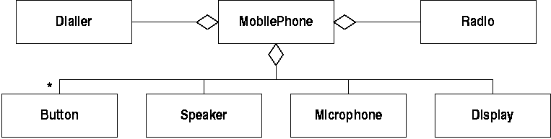
Design Based on Structure
It is sometimes tempting to base a design on the physical structure of the artefact being modelled
  for example, a mobile phone

Slide 20
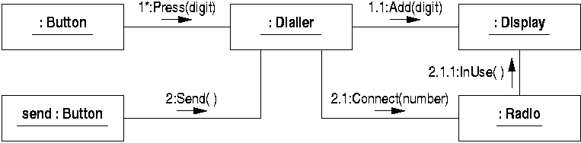
Realizing ‘Make a Call’
This interaction looks plausible:
But the associations based on the phone structure do not support these messages

Slide 21
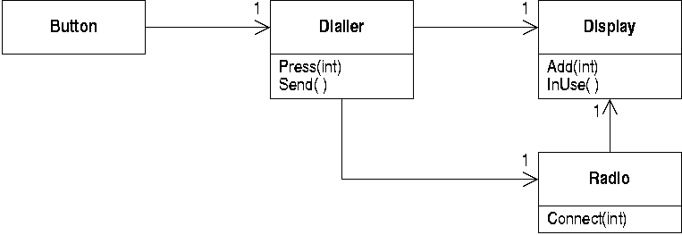
Design Based on Interactions
A better model of the phone is derived from the interactions in the realization

Slide 22
Design Patterns
Solutions to common design problems
Catalogued and published to aid reuse
A pattern consists of:
  a name, for easy reference
  a description of the problem being solved
  a description of the solution proposed
  a discussion of the consequences of adopting the pattern

Slide 23
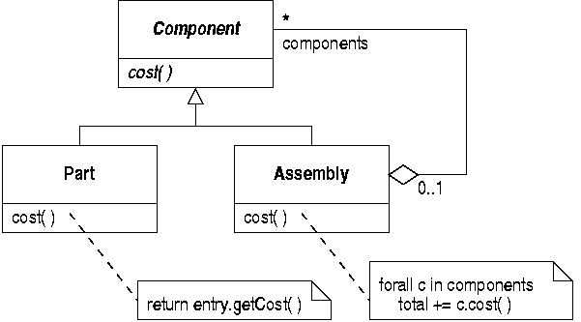
Recursive Structures
Many data structures are recursive, eg

Slide 24
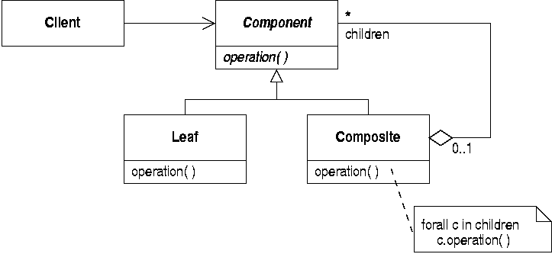
The ‘Composite’ Pattern
‘Composite’ defines the essential properties of this sort of situation

Slide 25
Discussion of Composite
The problem is how to implement tree-like structures
The diagram shows only the solution
  ‘Leaf’ and ‘Composite’ classes share a common interface, defined in ‘Component’
  ‘Composite’ implements this by iterating through all its components

Slide 26
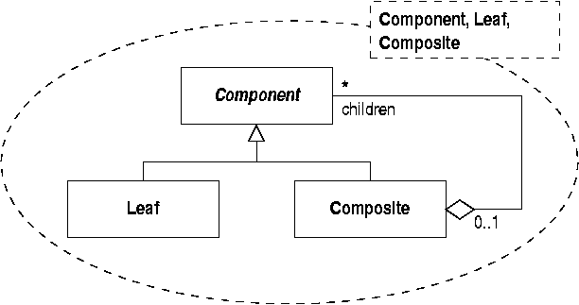
Patterns in UML
UML documents patterns as parameterized collaborations

Slide 27
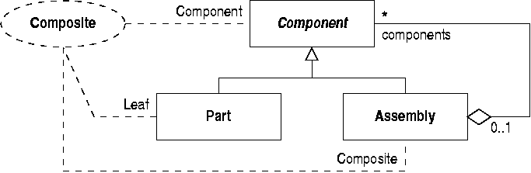
Documenting Pattern Application
When applying a pattern you must show what the its classes correspond to

Slide 28
The ‘State’ Pattern
Problem: how to ‘allow an object to alter its behaviour when its internal state changes’
  applicable if a class is described by a statechart
Solution: represent each state by a separate class
  each state class will implement the behaviour appropriate for each operation in that state only

Slide 29
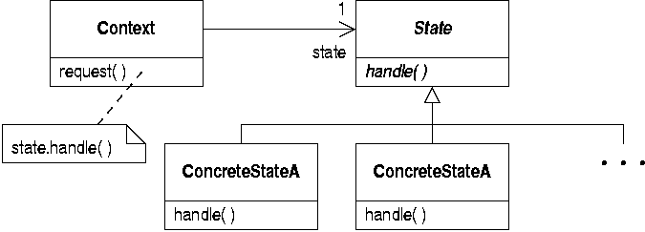
The ‘State’ Solution
A consequence of this pattern is that the state classes need access to the internal details of the context class

Slide 30
The ‘Strategy’ Pattern
Problem: how to allow different instances of a class to support different implementations of an operation
Solution: separate out the implementation of the operation into a new class hierarchy
  link each instance to a particular implementation object

Slide 31
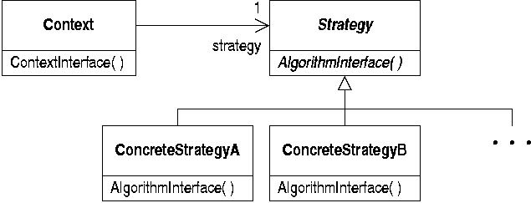
The ‘Strategy’ Solution
The structure is very similar to that of ‘State’
  treated as a different pattern because the problem being solved is different

Slide 32
Models, Views and Controllers
MVC: a design proposal put forward for the Smalltalk language
  to design programs with graphical interfaces
  separates manipulation and presentation of data
Now widely used in a variety of contexts
  the model stores and maintains data
  views display data in specific ways
  controllers detect and forward user input

Slide 33
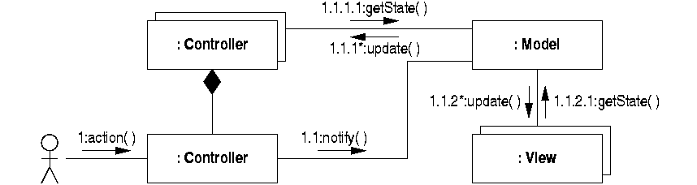
Interactions in MVC
User input detected by a controller
The model is notified
The views are updated

Slide 34
Document/View Architecture
Widely used by Microsoft
A simplification of MVC
  ‘Views’ combine the functions of MVC views and controllers

Slide 35
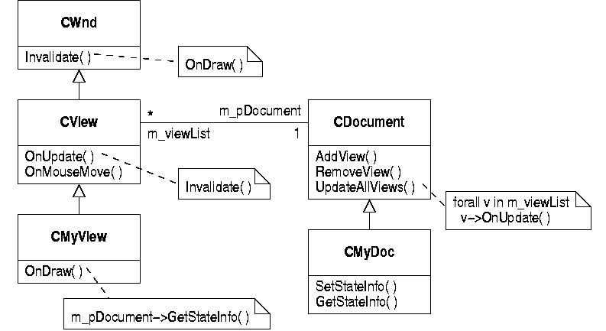
Document/View Structure

Slide 36
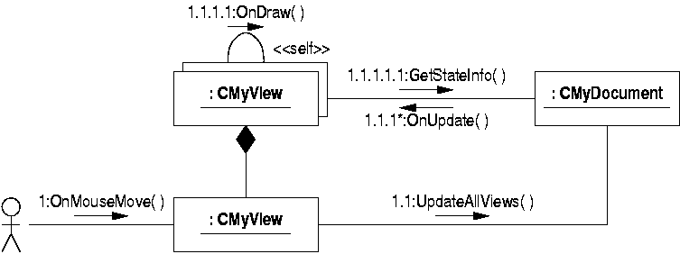
Document/View Interactions
Compare this with the MVC interaction

Slide 37
The ‘Observer’ Pattern
Problem: to define a dependency between objects so that when one object changes state all its dependants are notified
Solution: like MVC, separate ‘subject’ (ie model) from ‘observer’ (ie view)

Slide 38
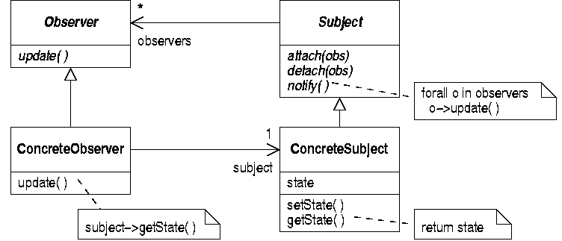
‘Observer’ Structure

Slide 39
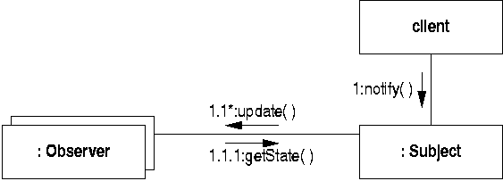
‘Observer’ Interactions
This interaction is simpler because the initial message is sent straight to the ‘model’ class

Slide 40
Parts Explosion
New requirement for the stock control program
  print a listing of all the parts and subassemblies in an assembly
Simple approach:
  add an ‘explode’ operation to each class
  call it recursively, like the existing ‘cost’ operation

Slide 41
Problems
There are a number of problems with this
  this approach involves changes to every class in the hierarchy
  the code that controls the recursion is repeated in both ‘cost’ and ‘explode’
  model classes like ‘Part’ should not produce output
Is there a pattern that can help?

Slide 42
The ‘Visitor’ pattern
Problem: Visitor lets you define a new operation without changing the classes of the elements on which it operates
Solution: define a ‘visitor’ class and an operation in each class to be visited to ‘accept’ a visitor
Consequence: the design becomes more complex, but more extendible

Slide 43
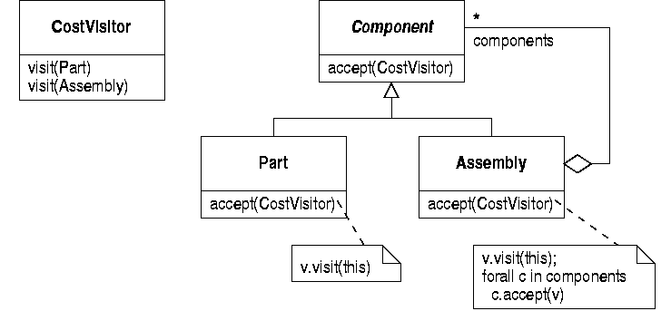
Finding Costs with Visitor
This illustrates Visitor with a single operation

Slide 44
The ‘CostVisitor’ Class
‘CostVisitor’ gets ‘called’ for each component and keeps track of the total cost of parts
    public class CostVisitor
    {
    private int total ;
    public void visit(Part p) {
    total += p.cost() ;
    }
    public void visit(Assembly a) {}
    }

Slide 45
Finding the Cost
We no longer call a cost function belonging to an assembly
Instead, we pass a cost visitor to it
    Assembly a ;
    CostVisitor visitor = new CostVisitor() ;
    a.accept(visitor) ;
    int cost = visitor.getTotal() ;

Slide 46
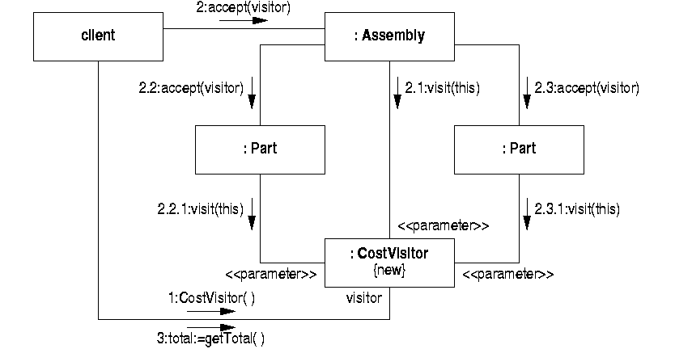
‘Visitor’ Interactions

Slide 47
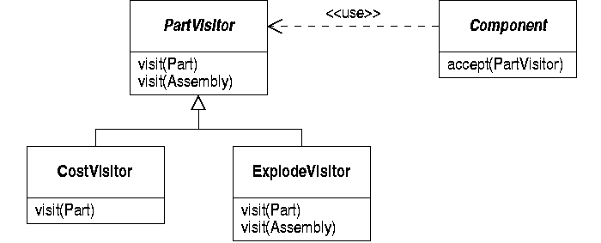
Adding Part Explosions
Extend the design by defining a visitor hierarchy

